Slide 2
Project 2010 Extensibility
Microsoft Project 2010 Ignite

Slide 3
Agenda
Extensibility overview
Project Desktop Extensibility
Project Server Extensibility
Key Resources
http://msdn.microsoft.com/project
http://blogs.msdn.com/project_programmability/
Notes:
Broad Overview of Project 2010 Developer Investments
Project Client
Ribbon, Deprecations, 64-bit and VSTO
Project Server
Project Server Interface (PSI) enhancements
Workflows
Backwards Compatibility
Reporting
PWA Customizations
SharePoint Integration

Slide 4
Project Extensibility Overview
Project Professional/Standard 2010
Object Model, VBA, VSTO
Fluent UI, Backstage
Project Server 2010
Web Services – Project Server Interface (PSI) & Evening
Project Demand Management Workflow
Rich Reporting/Business Intelligence
Project Web App site modifications
Theming, Fluent UI, Extensible Grid
Project and SharePoint “better together”
Project Workspaces (SharePoint Sites)
Any other customizations/add-ons leveraging any of the SharePoint Enterprise Suite

Slide 5
Project Desktop 2010 Extensibility
Microsoft Project 2010 Ignite

Slide 6
Project 2010 “desktop” extensibility WITHOUT code
“Custom Fields”
Custom metadata associated with tasks, resources, assignments and (projects)
Could have an icon representation and formulas
Views Modification
Adding columns, custom grouping and filtering, e.g. based on the Custom Fields
Custom Visual Reports
Manage your custom templates for Excel and Visio – based reporting

Slide 7
Project 2010 “desktop” extensibility WITH code
Desktop Object Model (OM)
Rich customizations and add-ons leveraging Project functionality including scheduling
Visual Basic for Applications (VBA) or Visual Studio Tools for Office (VSTO) could be used
User Interface (UI) modifications
Ribbon
Backstage

Slide 8
Visual Studio Tools for Office Getting Started
demo
Notes:
Open VS and create new Project 2007 Add-in
Point to WinProj.exe
Project → NAME Properties…
Debug
Start external program:
Build Solution
Run the VSTO Installer
“Hello World” example
using System.Windows.Forms;
MessageBox.Show("Hello World");
Show how to manage the Add-In from the Backstage

Slide 9
Related Resources
WebCasts (http://www.microsoft.com/events/series/epm.aspx)
MSDN Webcast: Project 2010 and Project Server 2010 Programmability (Level 200) by Chris Boyd
MSDN Webcast: Project 2010 User Interface Customizations by Chris Boyd
MSDN Webcast: Project 2010 Powerful Extensibility Using Visual Studio Tools by Jim Aksel, Project MVP
Project Developer Center
http://msdn.microsoft.com/project
Project “Programmability” blog
http://blogs.msdn.com/project_programmability

Slide 10
Project Server Extensibility Overview
Microsoft Project 2010 Ignite

Slide 11
Project Server Extensibility
Project 2003
Project 2007
Project 2010
Notes:
Project 2003
Project Data Service (PDS)
Server side API
XML based
PDS Extensions
SQL Triggers required to implement business logic extensions
Project Professional required for scheduling projects
Project Professional direct database connection
Project 2007
Great Extensibility / Development platform
Extensive
Anything you can do in PWA, you can do through custom code
Improve developer productivity
.Net Technology
Consistency
Firewall friendly
Project Server 2010 builds on these Goals

Slide 12
Related Resources
WebCasts (http://www.microsoft.com/events/series/epm.aspx)
MSND WebCasts (http://msdn.microsoft.com/en-us/office/dd334415.aspx)
Project Server Programmability, Part 1: Project Server 2007 Architecture for Developers
Project Server Programmability, Part 2: Project Server Interface Programming Overview
Project Server Programmability, Part 3A: Review of the Project Server Interface Web Services
Project Server Programmability, Part 3B: Review of the Project Server Interface Web Services
Project Server Programmability, Part 4: Project Server 2007 Events and Workflow
Project Client Programmability
Project Server and Project Portfolio Server Advanced Customization

Slide 13
Project Server extensibility – what’s new in 2010

Slide 14
Project Server Architecture Overview
3rd Party Application
Project Professional
IE
WCF Forwarder
Web Service
Forwarder
Project Web App
WSS and
MSS
3rd Party Application
WFE
Web Services
WCF Service
WSS and
MSS
Events
Business Objects
Queue
App Server
Data Access Layer (DAL)
MS SQL
Draft
Publish
Reporting
Archive
Content
Config

Slide 15

Project Server 2010 Interface
Admin
Object Link Provider
WSS Interop
Archive
Project
Driver
Calendar
Queue
Portfolio Analysis
Cube Admin
Resource
Workflow
Custom Fields
Resource Plan
Events
Security
Lookup Table
Statusing
Notifications
Timesheet

Slide 16
Other important enhancements
Status Broker
Impersonation
Department specific “PSI” calls
…

Slide 17
Related Resources
WebCasts (http://www.microsoft.com/events/series/epm.aspx)
MSDN Webcast: Project 2010 and Project Server 2010 Programmability (Level 200) by Chris Boyd
MSDN Webcast: Project 2010 Software Development Kit (SDK) Drill-down (Level 200) by Jim Corbin
Project Developer Center
http://msdn.microsoft.com/project
Project “Programmability” blog
http://blogs.msdn.com/project_programmability

Slide 18
Customizing the Demand Management Experience
Microsoft Project 2010 Ignite

Slide 19
Project Workflow Architecture
Project Workflows
Project Server 2010
Windows SharePoint Service
Windows Workflow Foundation
.NET Framework 3.5
Notes:
Workflow is a big piece, unlike the other web methods workflow is running underneath the hood all the time. Plus your hear for SharePoint so we might as well discuss it

Slide 20











Project Workflow Overview
Allows for custom project selection process
Custom Workflows created in VS2010
No Support for SharePoint Designer (SPD)
Enterprise Project Management
Create
Select
Plan
Manage
Demand Management
Portfolio Selection
Work Planning
Collaboration & Reporting

Slide 21
Related Resources
WebCasts (http://www.microsoft.com/events/series/epm.aspx)
MSDN Webcast: Project 2010 Software Development Kit (SDK) Drill-down (Level 200) by Jim Corbin
MSDN Webcast: Project 2010 Tailored Tools for Workflow Creation by Sam Chung
MSDN Webcast: Project 2010 Workflow Deep Dive (Part 1 of 2): PWA & Admin Experience by Sam Chung
MSDN Webcast: Project 2010 Workflow Deep Dive (Part 2 of 2): Workflows in Visual Studio by Sam Chung

Slide 22
Project Web App Customization
Microsoft Project 2010 Ignite

Slide 23
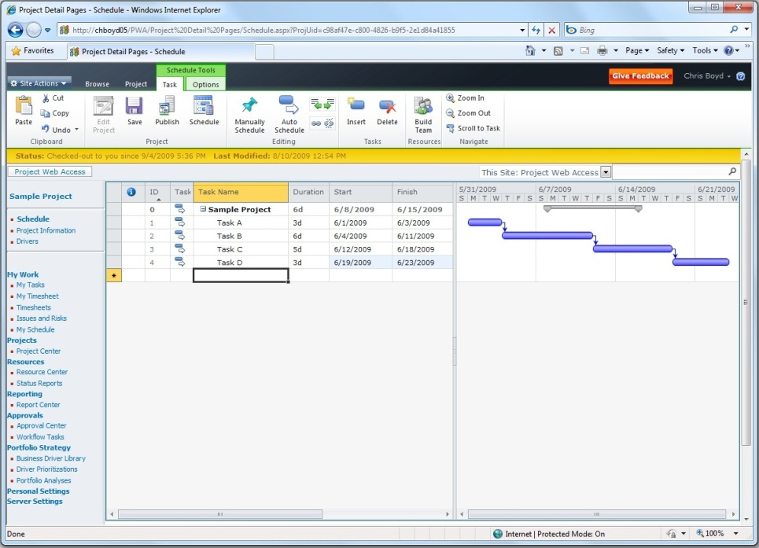
New Grid Control
JavaScript (Not ActiveX)
Multi-Browser Support
IE7, IE8, Firefox, Safari (tier 2)
PWA only supports IE7 and IE8
Ships with SharePoint
Feature Rich:
Copy and Paste (from Excel and others)
Multi-Level Undo
Change Highlighting
Cell Level Errors
Time-phased or Pivoted View
Dynamic Paging
Notes:
JSON or XML, you choose how you want to send over the data
C sharp interface for data binding (like to a SharePoint list)
JavaScript interface for more complex behaviors

Slide 24
Related Resources
WebCasts (http://www.microsoft.com/events/series/epm.aspx)
MSDN Webcast: Project 2010 Software Development Kit (SDK) Drill-down (Level 200) by Jim Corbin
MSDN Webcast: Project 2010 JS Grid Extensibility – Part 1,2 and 3 by Pat Malatack
Project Developer Center
http://msdn.microsoft.com/project
Project “Programmability” blog
http://blogs.msdn.com/project_programmability

Slide 25
Project 2010 Solution Starters
Microsoft Project 2010 Ignite

Slide 26
Solution Starters?
Goal: Create sample code for our customers and partners to use as starting blocks for creating their own solutions
Programs
Enterprise Project Type
Export/Import
Association Tool
Dynamic Workflow
Export Project Data To Office
InfoPath Form Viewer
Project Workspace List Viewer
Workflow Visualization
…
More on Project Developer Center http://msdn.microsoft.com/project
Notes:
JSON or XML, you choose how you want to send over the data
C sharp interface for data binding (like to a SharePoint list)
JavaScript interface for more complex behaviors

Slide 27
Related Resources
WebCasts (http://www.microsoft.com/events/series/epm.aspx)
MSDN Webcast: Project 2010 Solution Starters, Part 1 and 2 – by Sam Chung and Bobby Burns
MSDN Webcast: Project 2010 Solution Starters Drilldown & Code Walkthrough , Part 1 to 4 – by Mike Shughrue
Project Developer Center
http://msdn.microsoft.com/project
Project “Programmability” blog
http://blogs.msdn.com/project_programmability

Slide 28
SharePoint Integration
Microsoft Project 2010 Ignite

Slide 29
SharePoint 2010 Powerful and extensible platform
SharePoint 2010 development experience fully integrated with Visual Studio 2010
Developer Dashboard
Line of Business Integration
Business Connectivity Services
…
http://msdn.microsoft.com/sharepoint/

Slide 30

- Resources
Product information and trial download
http://www.microsoft.com/project
Project Team Blog http://blogs.msdn.com/project
Interactive content - Videos & Sessions & Webcasts
http://www.microsoft.com/showcase/en/US/channels/microsoftproject
http://www.microsoft.com/events/series/epm.aspx
IT Professional related
TechCenter @ TechNet http://technet.microsoft.com/ProjectServer
Admin Blog http://blogs.technet.com/projectadministration
Developer related
Developer center @ MSDN http://msdn.microsoft.com/Project
Programmability blog http://blogs.msdn.com/project_programmability
Additional questions? Project 2010 Forums!
http://social.msdn.microsoft.com/Forums/en-US/category/projectserver2010,projectprofessional2010
SharePoint 2010
http://sharepoint.microsoft.com
FORUMS
Project Professional 2010
General Questions and Answers
Project Server 2010
General Questions and Answers
Setup, Upgrade, Administration and Operation
Customization and Programming

Slide 31

© 2009 Microsoft Corporation. All rights reserved. Microsoft, Windows, Windows Vista and other product names are or may be registered trademarks and/or trademarks in the U.S. and/or other countries.
The information herein is for informational purposes only and represents the current view of Microsoft Corporation as of the date of this presentation. Because Microsoft must respond to changing market conditions, it should not be interpreted to be a commitment on the part of Microsoft, and Microsoft cannot guarantee the accuracy of any information provided after the date of this presentation. MICROSOFT MAKES NO WARRANTIES, EXPRESS, IMPLIED OR STATUTORY, AS TO THE INFORMATION IN THIS PRESENTATION.

